Slide 1

STATISTICS (PART 1)
09/09/2025

Slide 2

Contents
Introduction (What is statistics, why do we need statistics, use case examples).
Statistics (Statistical methods, Use in data science)
Descriptive Statistics (Definition, measures, Examples).
Outliers
Inferential statistics (Definition, types, examples).
Differences between inferential and descriptive statistics
Types of data
Recap

Slide 3

WHAT IS STATISTICS
Statistics is the science of collecting, analyzing, presenting and interpreting data. We can say what we now know as data science today is a combination of statistics and programming.
It is largely the branch of mathematics concerned with analyzing numerical data.
Statistics is often used (incorrectly) interchangeably with probability. Probability is more about chances while statistics is concerned about how we handle our data. Probability denotes the possibility of an event occurring while statistics is a method/science /mathematics of data

Slide 4
WHAT IS STATISTICS
Statistics uses analytical methods which provide the math to model and predict variation.
It also uses graphical methods to help making numbers visible for communication purposes.

Slide 5
WHY DO WE NEED STATISTICS?
Generally to aid decision making such as:
To find why a process behaves the way it does.
To find why it produces defective goods or services.
To summarize data for public use
To check the accuracy and precision of the process.
To prevent problems caused by assignable causes of variation.
To reduce variability and improve process capability.
To know the truth about the real world.

Slide 6
Use case examples
In biological and medical sciences, it helps personnel / researcher discover relationship worthy of further investigation
ex. A doctor can find if there is a correlation between drinking and kidney failure
Helps to prove theories and hypothesis that cannot be justified using rationale or ideas that are generally counter intuitive.
ex. There are studies that proof that shorter length of courtship and lower age of marriage reduces the chance of divorce

Slide 7
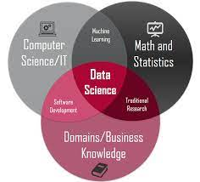
Relevance to data science
The basis of data science is statistics. Data science is essentially statistics and programming.
Most data science concepts have roots in statistics, thus an understanding of statistics is required in understanding key data science concept
Our approach to data in data science is rooted in statistics. For example, without stat, how do we recognize the type of distribution a data has,or know what effect distribution types has on handling data.
Notes:
https://datascience.virginia.edu/news/how-much-do-data-scientists-need-know-about-statistics

Slide 8
Main statistical methods
There are majorly 2
Descriptive statistics
Methods concerned with Prediction, inferences,
conclusion
Inferential statistics
Methods concerned with Collection, description, analysing…

Slide 9
Descriptive statistics
Descriptive statistics just like its name merely describes a dataset. It summarizes the properties of the data. We can think of it as data exploration
This is usually the first step in statistical analysis. The dataset is described to observe relationships between variables, or just observe general characteristics of the data
It allows us to make sense of the data

Slide 10
Descriptive statistics
For example, we may be concerned about describing:
The weight of a product in a production line.
The time taken to process an application.
In summary,
Descriptive statistics involves describing, summarizing and organizing the data so it can be easily understood.

Slide 11
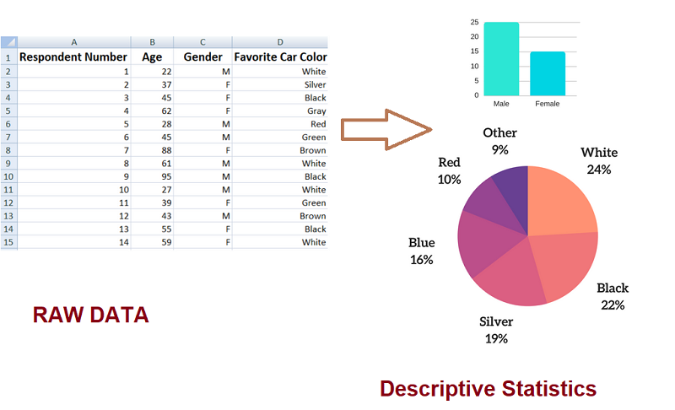
Descriptive statistics
Graphical displays are often used along with the quantitative measures to enable clarity of communication

Slide 12

Descriptive statistics
When analyzing a graphical display, you can draw conclusions based on several characteristics of the graph You may ask questions such ask:
Where is the approximate middle, or center, of the graph?
How spread out are the data values on the graph?
What is the overall shape of the graph?
Does it have any interesting patterns?
From Continuous Improvement Toolkit . www.citoolkit.com

Slide 13
Types of descriptive statistics
Measures of Frequency
Measures of Central Tendency
Measures of Dispersion or Variation

Slide 14
Types of descriptive statistics
Measures of Frequency
It is also called measures of shape. It deals with how a data is distributed. Here we talk about variable count, frequency of occurrence, or even percent distribution. Essentially, it says how often something occurs.
Plotting the data into an histogram would reveal the shape of the data and thus shows its distribution. Data usually follows a particular distribution. This distribution/shape reveals a lot about the data

Slide 15
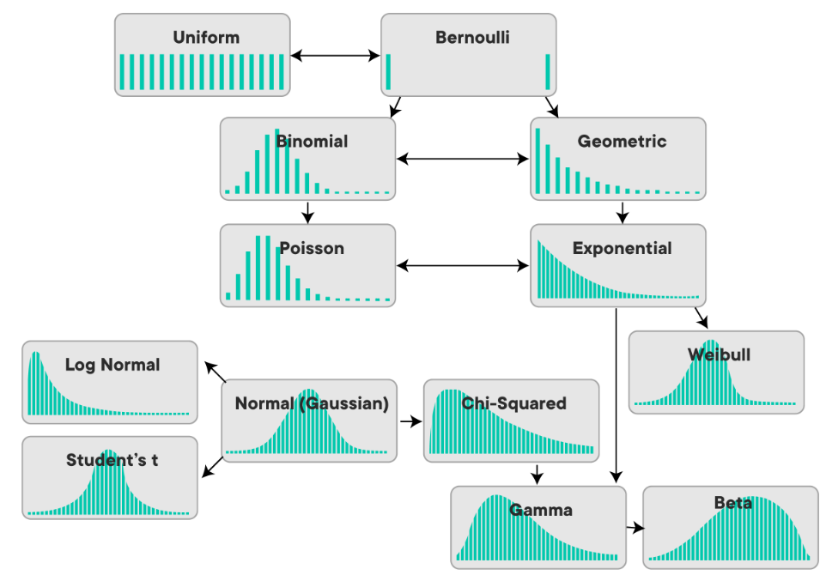
Types of descriptive statistics
Measures of Frequency
The distribution or shape can by symmetrical or non-symmetrical.
Symmetrical means the sides of the distribution are mirror images
The shape tells us what descriptive statistical analysis is more appropriate for a dataset.

Slide 16
Types of descriptive statistics
Measures of Frequency
For example, a mean or median is an appropriate measure of central tendency for symmetrical data while median will be more useful in non-symmetrical data.
Skewness and Kurtosis are concepts that are used in describing the shape of data.
Skewness answers the question of whether a dataset is distributed equally (symmetrically)around the mean
Skewness = 0 (symmetrical data)
Skewness = negative value (distribution is skewed to the left)
Skewness = positive values (distribution is skewed to the right)
Notes:
https://www.analyticsvidhya.com/blog/2021/05/shape-of-data-skewness-and-kurtosis/

Slide 17
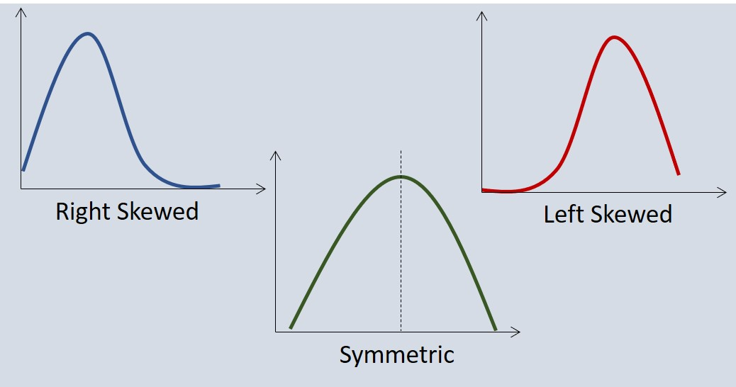
Types of descriptive statistics
Measures of Frequency

Slide 18
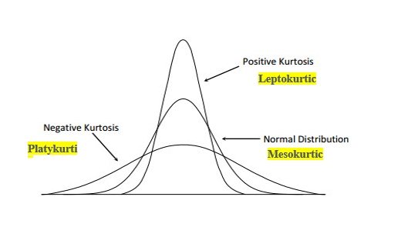
Types of descriptive statistics
Measures of Frequency
Kurtosis is a measure of whether the data are heavy-tailed or light-tailed relative to a normal distribution. That is, data sets with high kurtosis tend to have heavy tails, or outliers. Data sets with low kurtosis tend to have light tails, or lack of outliers.
Notes:
Leptokurtic or heavy-tailed distribution (kurtosis more than normal distribution).
Mesokurtic (kurtosis same as the normal distribution).
Platykurtic or short-tailed distribution (kurtosis less than normal distribution).

Slide 19

Types of descriptive statistics
Measures of central tendency
This estimates the center or midpoint of a dataset. This is also called measures of position. Herein we deal with averages such as mean, median, mode. Central tendency means where the data is centered.

Slide 20
Types of descriptive statistics
Measures of central tendency
Mean
This the most common measure of average. The mean is given as the sum of all the values of a variable divided by the number of observations. It is best used when the data is symmetrical and without outliers.
Median
This is the value right at the middle of a data set. The median is robust and can reduce the effect outliers. It is often used when data is asymmetrical. Before calculating the median, the values must be ordered.

Slide 21
Types of descriptive statistics
Measures of central tendency
Mode
The mode is the value with the highest frequency. It is rarely used as a measure of central tendency. Mode is more useful in determining if a distribution is unimodal or multimodal.
Multimodal = more than one peak(mode)

Slide 22
Types of descriptive statistics
Measures of spread
Also known as measure of variability or dispersion. Here, we want to know how spread out a distribution is or how the dataset deviates from the position measure. It shows the variation in datapoints.
There are different statistics by which we can describe the spread of a data set:
Range
Standard deviation.
Notes:
https://www.analyticsvidhya.com/blog/2021/05/shape-of-data-skewness-and-kurtosis/

Slide 23
Types of descriptive statistics
Measures of spread
Range
The range gives you an idea of how far apart the most extreme response scores are. To find the range, simply subtract the lowest value from the highest value. The range can be misleading in the presence of an outlier or when the dataset is skewed.
Standard deviation
The standard deviation is the average amount of variability in your dataset. It tells you, on average, how far each score lies from the mean. The larger the standard deviation, the more variable the data set is. Standard deviation is more robust to outliers
s = standard deviation
x = mean
x = values of the data set n = size of the data set
∑ ( x – x )²
s =
n - 1
Notes:
https://www.analyticsvidhya.com/blog/2021/05/shape-of-data-skewness-and-kurtosis/

Slide 24
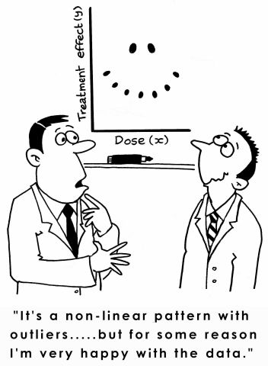
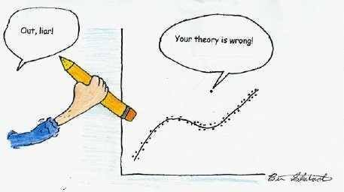
Outliers

Slide 25
Outliers
Outlier is data point that is significantly greater or smaller than other data points in a data set.
It is useful when analyzing data to identify outliers as they may affect the calculation of descriptive statistics.
Outliers can occur in any given data set and in any distribution and may indicate an experimental error or incorrect recording of data. They may also occur by chance.
In some cases it may be normal to have high or low data points.
Before carrying out your analysis, you must decide whether to include or exclude the outliers. An outlier should be excluded if it is due to measurement or human error.

Slide 26

Outliers
It is clear that one data point is far distant from the rest of the values.
This point is an ‘outlier’

Slide 27
Inferential statistics
Inferential statistics are used to draw conclusion about a population by observing a sample. This branch of statistics is concerned with using analytical tools to draw inferences about a population using a representative dataset. This is different from descriptive statistics in the sense that it draws conclusion from a dataset while descriptive stat summarizes the dataset.
There are two main types of inferential statistics - hypothesis testing and regression analysis. The samples chosen in inferential statistics need to be representative of the entire population. This is important for us as data scientist to ensure that the data we are drawing conclusions from is actually a reflection of the population. Accuracy of inference depends on this.

Slide 28
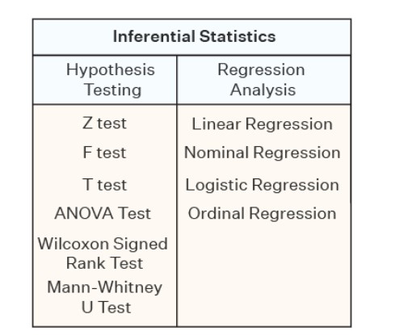
Types of inferential statistics
Notes:
https://www.analyticsvidhya.com/blog/2021/05/shape-of-data-skewness-and-kurtosis/

Slide 29
Types of inferential statistics
Hypothesis testing
Is a type of inferential statistics that is used to test assumptions and draw conclusions about the population from the available sample data.
It involves setting up a null hypothesis and an alternative hypothesis followed by conducting a statistical test of significance. A conclusion is drawn based on the value of the test statistic.
Hypothesis tests are as given in the previous slides. The test to be used depends on the data type. We’ll discuss data types in subsequent class
Notes:
https://www.slideshare.net/lovelynisha01/inferential-statistics-105742745

Slide 30
Types of inferential statistics
Regression Analysis
Regression analysis is used to quantify how one variable will change with respect to another variable. There are many types of regressions available such as simple linear, multiple linear, nominal, logistic, and ordinal regression.

Slide 31
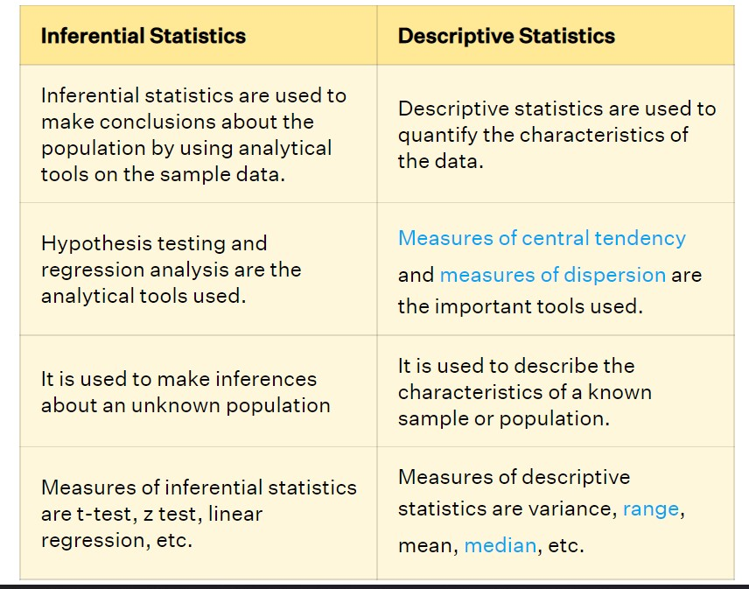
Types of inferential statistics
Notes:
https://www.cuemath.com/data/inferential-statistics/

Slide 32
Data and data types

Slide 33
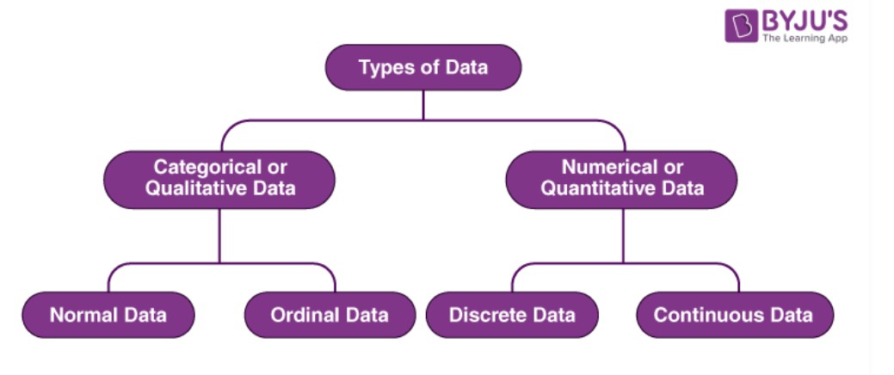
Types of Data

Slide 34
Types of Data
The data is classified into majorly four categories:
Nominal data
Ordinal data
Discrete data
Continuous data

Slide 35
Types of Data
Qualitative or Categorical Data
Qualitative data, also known as the categorical data, describes the data that fits into the categories. Qualitative data are not numerical. The categorical information involves categorical variables that describe the features such as a person’s gender, home town etc. Categorical measures are defined in terms of natural language specifications, but not in terms of numbers.
Sometimes categorical data can hold numerical values (quantitative value), but those values do not have a mathematical sense. Examples of the categorical data are birthdate, favourite sport, school postcode. Here, the birthdate and school postcode hold the quantitative value, but it does not give numerical meaning

Slide 36
Types of Data
Qualitative or Categorical Data
Nominal and ordinal data falls under this data type
Nominal Data
Nominal data is one of the types of qualitative information which helps to label the variables without providing the numerical value. Nominal data is also called the nominal scale. It cannot be ordered and measured. But sometimes, the data can be qualitative and quantitative. Examples of nominal data are letters, symbols, words, gender etc.
Nominal data is data that can be labelled or classified into mutually exclusive categories within a variable. For example, for the nominal variable of preferred mode of transportation, you may have the categories of car, bus, train, tram or bicycle.. These data are visually represented using the pie charts.

Slide 37
Type of Data & Analysis
Logistics regression
When to use it?
When you want to measure the strength and direction of the association between two variables, where the dependent or outcome variable is categorical (e.g., yes/no)
When you want to predict the likelihood of an outcome while controlling for confounders
Ex) examine the relationship between health behavior (smoking, exercise, low-fat diet) and arthritis (arthritis vs. no arthritis)
Ex) Predict the probability of stroke in relation to gender while controlling for age or hypertension

Slide 38
Use case examples
In biological and medical sciences, it helps personnel / researcher discover relationship worthy of further investigation
ex. A doctor can find if there is a correlation between drinking and kidney failure
Helps to prove theories and hypothesis that cannot be justified using rationale or ideas that are generally counter intuitive.
ex. There are studies that proof that shorter length of courtship and lower age of marriage reduces the chance of divorce

Slide 39
Relevance to data science
The basis of data science is statistics. Data science is essentially statistics and programming.
Most data science concepts have roots in statistics, thus an understanding of statistics is required in understanding key data science concept
Our approach to data in data science is rooted in statistics. For example, without stat, how do we recognize the type of distribution a data has,or know what effect distribution types has on handling data.
Notes:
https://datascience.virginia.edu/news/how-much-do-data-scientists-need-know-about-statistics

Slide 40
Main statistical methods
There are majorly 2
Descriptive statistics
Methods concerned with Prediction, inferences,
conclusion
Inferential statistics
Methods concerned with Collection, description, analysing…

Slide 41
Descriptive statistics
Descriptive statistics just like its name merely describes a dataset. It summarizes the properties of the data. We can think of it as data exploration
This is usually the first step in statistical analysis. The dataset is described to observe relationships between variables, or just observe general characteristics of the data
It allows us to make sense of the data

Slide 42
Descriptive statistics
For example, we may be concerned about describing:
The weight of a product in a production line.
The time taken to process an application.
In summary,
Descriptive statistics involves describing, summarizing and organizing the data so it can be easily understood.

Slide 43
Descriptive statistics
Graphical displays are often used along with the quantitative measures to enable clarity of communication

Slide 44
Descriptive statistics
When analyzing a graphical display, you can draw conclusions based on several characteristics of the graph You may ask questions such ask:
Where is the approximate middle, or center, of the graph?
How spread out are the data values on the graph?
What is the overall shape of the graph?
Does it have any interesting patterns?
From Continuous Improvement Toolkit . www.citoolkit.com

Slide 45
Types of descriptive statistics
Measures of Frequency
Measures of Central Tendency
Measures of Dispersion or Variation

Slide 46
Types of descriptive statistics
Measures of Frequency
It is also called measures of shape. It deals with how a data is distributed. Here we talk about variable count, frequency of occurrence, or even percent distribution. Essentially, it says how often something occurs.
Plotting the data into an histogram would reveal the shape of the data and thus shows its distribution. Data usually follows a particular distribution. This distribution/shape reveals a lot about the data

Slide 47
Types of descriptive statistics
Measures of Frequency
The distribution or shape can by symmetrical or non-symmetrical.
Symmetrical means the sides of the distribution are mirror images
The shape tells us what descriptive statistical analysis is more appropriate for a dataset.

Slide 48
Types of descriptive statistics
Measures of Frequency
For example, a mean or median is an appropriate measure of central tendency for symmetrical data while median will be more useful in non-symmetrical data.
Skewness and Kurtosis are concepts that are used in describing the shape of data.
Skewness answers the question of whether a dataset is distributed equally (symmetrically)around the mean
Skewness = 0 (symmetrical data)
Skewness = negative value (distribution is skewed to the left)
Skewness = positive values (distribution is skewed to the right)
Notes:
https://www.analyticsvidhya.com/blog/2021/05/shape-of-data-skewness-and-kurtosis/

Slide 49
Types of descriptive statistics
Measures of Frequency

Slide 50
Types of descriptive statistics
Measures of Frequency
Kurtosis is a measure of whether the data are heavy-tailed or light-tailed relative to a normal distribution. That is, data sets with high kurtosis tend to have heavy tails, or outliers. Data sets with low kurtosis tend to have light tails, or lack of outliers.
Notes:
Leptokurtic or heavy-tailed distribution (kurtosis more than normal distribution).
Mesokurtic (kurtosis same as the normal distribution).
Platykurtic or short-tailed distribution (kurtosis less than normal distribution).

Slide 51
Types of descriptive statistics
Measures of central tendency
This estimates the center or midpoint of a dataset. This is also called measures of position. Herein we deal with averages such as mean, median, mode. Central tendency means where the data is centered.

Slide 52
Types of descriptive statistics
Measures of central tendency
Mean
This the most common measure of average. The mean is given as the sum of all the values of a variable divided by the number of observations. It is best used when the data is symmetrical and without outliers.
Median
This is the value right at the middle of a data set. The median is robust and can reduce the effect outliers. It is often used when data is asymmetrical. Before calculating the median, the values must be ordered.

Slide 53
Types of descriptive statistics
Measures of central tendency
Mode
The mode is the value with the highest frequency. It is rarely used as a measure of central tendency. Mode is more useful in determining if a distribution is unimodal or multimodal.
Multimodal = more than one peak(mode)

Slide 54
Types of descriptive statistics
Measures of spread
Also known as measure of variability or dispersion. Here, we want to know how spread out a distribution is or how the dataset deviates from the position measure. It shows the variation in datapoints.
There are different statistics by which we can describe the spread of a data set:
Range
Standard deviation.
Notes:
https://www.analyticsvidhya.com/blog/2021/05/shape-of-data-skewness-and-kurtosis/

Slide 55
Types of descriptive statistics
Measures of spread
Range
The range gives you an idea of how far apart the most extreme response scores are. To find the range, simply subtract the lowest value from the highest value. The range can be misleading in the presence of an outlier or when the dataset is skewed.
Standard deviation
The standard deviation is the average amount of variability in your dataset. It tells you, on average, how far each score lies from the mean. The larger the standard deviation, the more variable the data set is. Standard deviation is more robust to outliers
s = standard deviation
x = mean
x = values of the data set n = size of the data set
∑ ( x – x )²
s =
n - 1
Notes:
https://www.analyticsvidhya.com/blog/2021/05/shape-of-data-skewness-and-kurtosis/

Slide 56
Outliers

Slide 57
Outliers
Outlier is data point that is significantly greater or smaller than other data points in a data set.
It is useful when analyzing data to identify outliers as they may affect the calculation of descriptive statistics.
Outliers can occur in any given data set and in any distribution and may indicate an experimental error or incorrect recording of data. They may also occur by chance.
In some cases it may be normal to have high or low data points.
Before carrying out you analysis, you must decide whether to include or exclude the outliers. An outlier should be excluded if it is due to measurement or human error.

Slide 58
Outliers
It is clear that one data point is far distant from the rest of the values.
This point is an ‘outlier’

Slide 59
Inferential statistics
Inferential statistics are used to draw conclusion about a population by observing a sample. This branch of statistics is concerned with using analytical tools to draw inferences about a population using a representative dataset. This is different from descriptive statistics in the sense that it draws conclusion from a dataset while descriptive stat summarizes the dataset.
There are two main types of inferential statistics - hypothesis testing and regression analysis. The samples chosen in inferential statistics need to be representative of the entire population. This is important for us as data scientist to ensure that the data we are drawing conclusions from is actually a reflection of the population. Accuracy of inference depends on this.

Slide 60
Types of inferential statistics
Notes:
https://www.analyticsvidhya.com/blog/2021/05/shape-of-data-skewness-and-kurtosis/

Slide 61
Types of inferential statistics
Hypothesis testing
Is a type of inferential statistics that is used to test assumptions and draw conclusions about the population from the available sample data.
It involves setting up a null hypothesis and an alternative hypothesis followed by conducting a statistical test of significance. A conclusion is drawn based on the value of the test statistic.
Hypothesis tests are as given in the previous slides. The test to be used depends on the data type. We’ll discuss data types in subsequent class
Notes:
https://www.slideshare.net/lovelynisha01/inferential-statistics-105742745

Slide 62
Types of inferential statistics
Regression Analysis
Regression analysis is used to quantify how one variable will change with respect to another variable. There are many types of regressions available such as simple linear, multiple linear, nominal, logistic, and ordinal regression.

Slide 63
Types of inferential statistics
Notes:
https://www.cuemath.com/data/inferential-statistics/

Slide 64
Data and data types

Slide 65
Types of Data

Slide 66
Types of Data
The data is classified into majorly four categories:
Nominal data
Ordinal data
Discrete data
Continuous data

Slide 67
Types of Data
Qualitative or Categorical Data
Qualitative data, also known as the categorical data, describes the data that fits into the categories. Qualitative data are not numerical. The categorical information involves categorical variables that describe the features such as a person’s gender, home town etc. Categorical measures are defined in terms of natural language specifications, but not in terms of numbers.
Sometimes categorical data can hold numerical values (quantitative value), but those values do not have a mathematical sense. Examples of the categorical data are birthdate, favourite sport, school postcode. Here, the birthdate and school postcode hold the quantitative value, but it does not give numerical meaning

Slide 68
Types of Data
Qualitative or Categorical Data
Nominal and ordinal data falls under this data type
Nominal Data
Nominal data is one of the types of qualitative information which helps to label the variables without providing the numerical value. Nominal data is also called the nominal scale. It cannot be ordered and measured. But sometimes, the data can be qualitative and quantitative. Examples of nominal data are letters, symbols, words, gender etc.
Nominal data is data that can be labelled or classified into mutually exclusive categories within a variable. For example, for the nominal variable of preferred mode of transportation, you may have the categories of car, bus, train, tram or bicycle.. These data are visually represented using the pie charts.

Slide 69
Type of Data & Analysis
Logistics regression
When to use it?
When you want to measure the strength and direction of the association between two variables, where the dependent or outcome variable is categorical (e.g., yes/no)
When you want to predict the likelihood of an outcome while controlling for confounders
Ex) examine the relationship between health behavior (smoking, exercise, low-fat diet) and arthritis (arthritis vs. no arthritis)
Ex) Predict the probability of stroke in relation to gender while controlling for age or hypertension

Slide 70
Type of Data & Analysis
Logistics regression
What does it tell you?
The odds of an event occurring→ The probability of the outcome event occurring divided by the probability of it not occurring

Slide 71


